Slide 1
Rheumatic Emergency
Laboratory Role
Dr. Shereen H.Atef
Consultant clinical pathology
Alsalama Hospital

Slide 2
Prevalence of arthritis and joint pain
Do you have, or have you ever had arthritis or joint pain ?
%
Yes, have arthritis or joint pain
Aged 15 – 24 years
Aged 25 – 34 years
Aged 35 – 44 years
Aged 45 – 54 years
Aged 55 – 64 years
Aged 65+
10%
11%
18%
32%
49%
54%

Slide 3
Patients with connective tissue diseases and vasculitides may have dangerous or life threatening conditions, which must be recognised and treated to prevent rapidly evolving morbidity and mortality
The emergency room in systemic rheumatic diseases include:
Septic arthritis in RA patient
Renal crisis in systemic sclerosis
Alveolar haemorrhage in SLE
Hypokalemic paralysis in sjogren’s syndrome

Slide 4
Rheumatoid Arthritis

Slide 5
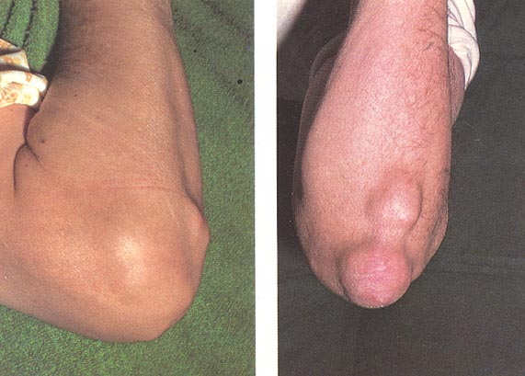
Rheumatoid arthritis
General
  prevalence
    1% of population
    2-3 times F>M
    4th and 5th decade
  signs and symptoms
    morning stiffness lasting greater than 30 min
    sub-Q rheumatoid nodules
    synovial fluid inflammation 2K - 75K 50% PMN’s

Slide 6
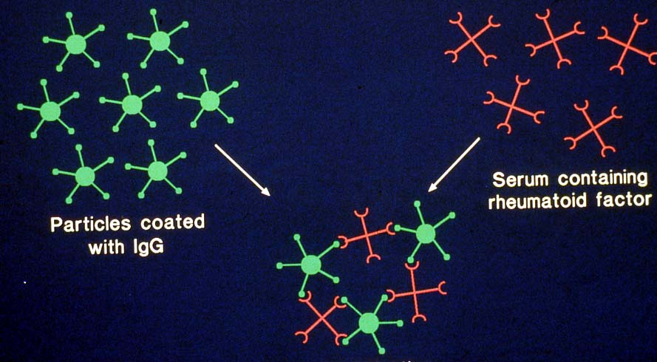
Rheumatoid factors
autoantibody against
Fc fragment of IgG
Rheumatoid factors
RA > 70% +ve
also
other rheumatic disorders
sarcoidosis
infections
old age etc
Frequency of false +ve RF
20 – 60 yrs 2 – 4 %
60 – 70 yrs 5%
>70 yrs 10 – 25%

Slide 7
Anti-CCP antibodies are potentially important markers for diagnosis and prognosis in rheumatoid arthritis (RA), because :
they are as sensitive as, and more specific than, IgM rheumatoid factors (RF) in early and fully established disease
may predict the eventual development into RA when found in undifferentiated arthritis
are a marker of erosive disease in RA
may be detected in healthy individuals years before onset of clinical RA

Slide 8
ARA criteria for diagnosis of rheumatoid arthritis
1. Morning stiffness
2. Arthritis of 3 or more joint areas
3. Symmetrical arthritis
4. Rheumatoid nodules
5. Serum rheumatoid factor
6. Radiographic changes
(four or more criteria suggest diagnosis)

Slide 9

The emergency room in systemic rheumatic diseases include:
Septic arthritis in RA patient
Renal crisis in systemic sclerosis
Alveolar haemorrhage in SLE
Hypokalemic paralysis in sjogren’s syndrome

Slide 10
SEPTIC ARTHRITIS
Occurs when bacteria from the circulation enter the joint space
Can occur directly from osteomyelitis or penetrating trauma
Causes destruction of articular cartilage because of the lack of normal nutrients in synovial space or a result of purulent exudate and increased pressure.
The joint involved is usually warm, swollen, and painful. Patient look s sick and holds hip in flexion and external rotation.
Joints involved : – Knee (40%), Hip (20%),Ankle (15%), Elbow (15%), Wrist (5%), Shoulder (5%)

Slide 11
Common organisms
Neonate
– Group B strep
– Staph Aureus
– Gram neg rods Gram neg rods
Children
– Staph Aureus
– Group A strep
– Step pneumo
– Neisseria meningitis
– H. flu
– Neisseriae gonorrhea

Slide 12
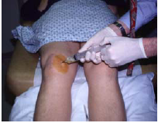
EXAMINATION OF SYNOVIAL
FLUID BY ASPIRATION

Slide 13
INVESTIGATION OF SYNOVIAL FLUID
Synovial fluid must be aspirated prior to starting antibiotics, Gram stained and cultured
(If affected joint is prosthetic seek orthopaedic advice)
Send specimen fresh to the laboratory for immediate microscopy and culture
Polarising microscopy to evaluate crystals must be carried out on all synovial fluid samples. The samples should be fresh and the microscopy performed by a microscopist experienced in crystal identification. (If unable to process samples immediately they should be stored at room temperature overnight to prevent artefactual crystal formation)
Neither the absence of organisms on Gram stain, nor a negative synovial fluid culture excludes the diagnosis of septic arthritis, although they make it less likely and alternative diagnoses should be considered

Slide 14
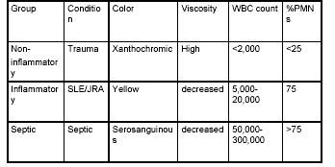
ANALYSIS OF SYNOVIAL
FLUID

Slide 15
Connective tissue diseases
Systemic lupus erythematosus
Scleroderma
  localised (CREST)
  Systemic (systemic sclerosis)
Myositis/Dermatomyositis
Sjogren’s syndrome
Mixed connective tissue disease
  SLE + SS + DM (RNP antibodies)

Slide 16
System Lupus Erythromatosus

Slide 17
Systemic lupus erythematosus
1. Commonest autoimmune, inflammatory, multisystem disease
2. Associated with pathogenic autoantibodies resulting in immune complex formation and complement mediated tissue damage
3. Characterised by remissions & relapses
4. Variable course and prognosis

Slide 18

Epidemiology
Prevalence
  total 28/100,000
    female 50/100,000 = 1/2000
  In women:
    Afro-Carib1/500; Asian 1/1,000; Caucasian 1/2,500
Incidence: total 4/100,000
    female 7/100,000
Survival : 5 years 93%, 10 years 85%
15 years 79%, 20 years 68%

Slide 19
Laboratory features
Anaemia
  haemolytic anaemia
  secondary to chronic disease
  blood loss (drugs?)
Leucopenia (drugs?)
  lymphopenia
  neutropenia
Thrombocytopenia
ESR/CRP
Urinalysis
Renal function
IgG/autoantibodies (ANA)
anti-dsDNA Abs (& ENA)
Complement (C3,C4,C3d)
Anti-cardiolipin antibodies

Slide 20
Auto antibodies in SLE to:
Ro and La
  20-60% and 15-40%
  cutaneous & neonatal lupus and congenital heart block
Sm
  10-30%
  ?nephritis and CNS disease
RNP
  10-30%
  Mixed connective tissue disease
dsDNA
  60% patients
  increased risk nephritis
Cardiolipin
  10-30%
  thrombosis, fetal loss

Slide 21
The emergency room in systemic rheumatic diseases include:
Septic arthritis in RA patient
Renal crisis in systemic sclerosis
Alveolar haemorrhage in SLE
Hypokalemic paralysis in sjogren’s syndrome

Slide 22
Alveolar hemorrhage (AH) is a potentially catastrophic complication of SLE
It is an uncommon complication, with frequency estimates ranging from < 2 to 5.4% in cohorts of lupus patients.
It accounts for 1.5 to 3.7% of hospital admissions due to SLE.
AH is frequently fatal, with reported mortality rates of 23 to 92%

Slide 23
Laboratory Investigations
A drop in hemoglobin > 1.0 g/dL with the clinical onset of AH
Erythrocyte sedimentation rates or C-reactive protein levels may be normal
Bronchoscopy with BAL shows:
The percentage of neutrophils ranged from 30 to 91%
lymphocytes ranged from 0 to 8%
Monocytes and macrophages comprised 1 to 45% of the differential cell count
Hemosiderin-laden or pigment-laden macrophages were seen in all fluids
Routine bacterial and fungal culture results were negative from all the initial blood, sputum, and BAL cultures

Slide 24
Scleroderma

Slide 25
Systemic sclerosis
Generalised disorder of CT affecting skin (scleroderma) and internal organs
Characterised by:
fibrotic arteriosclerosis of peripheral and visceral vasculature
Extracellular matrix accumulation (collagen) in skin and viscera
Associated with specific auto-antibodies
Localised (CREST) or systemic variants

Slide 26
Scleroderma
  prevalence
    4-12/million/year
    3-4 to 1 F>M
    30-50 yrs
    prognosis
      black worse white
      men worse women

Slide 27
Systemic Sclerosis: Autoantibodies
ANA
  90% patients
  limited+diffuse SSc
Centromere
  10-20%
  limited SSc with oesophageal disease and pulmonary HT
Scl-70 (Topoisomerase)
  15-25%
  diffuse SSc with widespread gut disease
Anti-RNA polymerase
  20%
  diffuse SSc with renal disease
U1RNP
  5-35%
  limited SSc

Slide 28
The emergency room in systemic rheumatic diseases include:
Septic arthritis in RA patient
Renal crisis in systemic sclerosis
Alveolar haemorrhage in SLE
Hypokalemic paralysis in sjogren’s syndrome

Slide 29
Renal crisis in systemic sclerosis
Approximately 10-45% of patients with systemic scleroderma develop a condition called scleroderma renal crisis within 4 years of the onset of the disease
Scleroderma renal crisis is characterized by:
Systemic hypertension (high blood pressure)
Hyperreninemia - elevation of rennin levels in the blood
Uremia - increased levels of urea in the blood
Microangiopathic hemolytic anemia
Kidney failure

Slide 30
Sjögren's Syndrome

Slide 31
Sjogren’s Syndrome:
Chronic inflammatory disorder featuring lymphocytic infiltration of exocrine glands
Characterized by dry eyes (keratoconjunctivitis sicca) and dry mouth (xerostomia)
May be primary, or associated with
-Rheumatoid arthritis
-Systemic Lupus Erythematosus
-Scleroderma

Slide 32
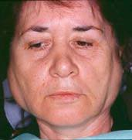

Sjögren's Syndrome - Autoimmune Epithelitis
Female disease
  ♀/♂ : 9/1
Common
  0.5-1% of adult females
4th -5th decade of life
Slowly progressive

Slide 33
Sjogren’s diagnosis
mostly clinical:
dry eyes, dry mouth
Laboratory tests:
-tests to document above(e.g. whole mouth sialometry)
-autoantibodies(anti-Ro/SSA anti-La/SSB)
-salivary histopathology showing foci of lymphocytes
-tests to rule out other connective tissue disorders

Slide 34
Sjögren's Syndrome - Autoimmune Epithelitis
Algorithm for the diagnosis
Dry mouth
Dry eyes
or
Salivary gland enlargement
or
Raynaud’s phenomenon
Purpura
Renal tubular acidosis
If any positive
Eye & salivary gland tests
Serology
If positive
Sjögren's Syndrome

Slide 35
Primary Sjögren's Syndrome
Systemic manifestations | Frequency (%)
Arthralgia/arthritis |  | 60
Raynaud’s phenomenon |  | 30
Purpura/Vasculitis |  | 15 (1)
Lung involvement |  | 10 (25)
Kidney involvement |  | 8 (25)
Liver involvement |  | 5
Muscle involvement |  | 1
Skopouli et al., Semin Arthritis Rheum. 2000, 29:296

Slide 36
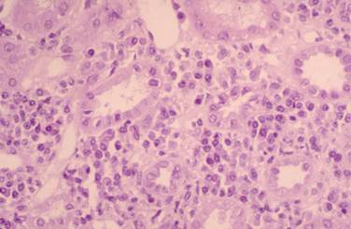
Primary Sjögren's Syndrome
Renal Involvement
Interstitial nephritis (25%)
  Asymptomatic-subclinical
  Proximal tubular acidosis
  Distal tubular acidosis
  Nephrocalcinosis
Glomerulonephritis (2.5%)
  Membranoproliferative
  Membranous
  Messangioproliferative

Slide 37
Distal renal tubular acidosis occurs in about 30% of patients with primary sjs.
RTA may lead to symptomatic hypokalaemic paralysis that rarely causes respiratory arrest.
Low serum potassium level along with hyperchloraemic metabolic acidosis and abnormally acidified urine may be diagnostic.

Slide 38
CONCLUSION
Systemic rheumatologic diseases rarely cause life-threatening illness, and when they do, it usually results from internal organ damage, such as alveolar hemorrhage in SLE or aortic arch dissection in temporal arteritis.
Alternatively, life-threatening illness may be a complication of treatment itself, such as infection in the setting of immunosuppression, or gastrointestinal hemorrhage complicating nonsteroidal anti-inflammatory drug (NSAID) use
Role of laboratory tests are mandatory to prevent serious morbidity and increased mortality if not recognized and managed correctly...."

Slide 39
Thank You

